Slide 1
DEPI Graduation Project
Talabat
Case Study

Slide 2
01
02
03
Introduction & Analysis
Dashboard
Prediction
About Dataset & Meta Data & Schema Diagram & Data Preparation
Data Analytics Dashboard
Prediction of actual delivery time

Slide 3

Introduction & Analysis

Slide 4
Talabat
Origins in Simplicity
Regional Expansion
Transformation from Otlob
Community Support
Innovation and Growth
talabat

Slide 5
Dataset
The dataset provides details about talabat orders from Sep_2021 to Jan_2022
The dataset contains three tables:
fct_order table: It contains details about the orders(order_id,order_time,vendo_id...etc).
dim_vendor table: It contains details about the vendors(vendo_id,name_en,..etc).
dim_date table: It contains details about the orders time.

Slide 6
MetaData
fct_order table:

Slide 7
MetaData
dim_vendor table:
dim_date table:

Slide 8
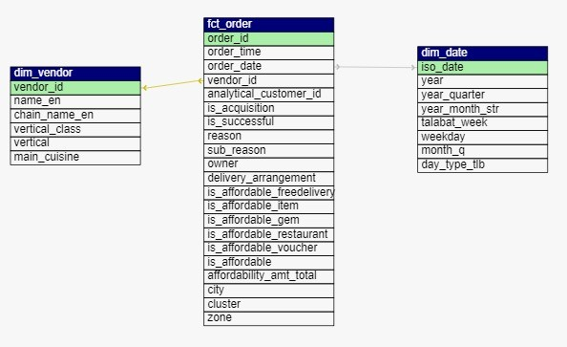
Schema Diagram

Slide 9
Data Preparation
Loading Data
Merging Data
Handling Missing Values
City Cluster Update
Saving Cleaned Data
As we saw the dataset and it's tables let's discover how we prepared it for our work:
Loading Data:
Data was loaded from two Excel files (dim_vendor.xlsx and fct_order.xlsx) using pd.read_excel().
Merging Data:
The two datasets were merged on the vendor_id column using pd.merge() to create a unified dataset

Slide 10
Data Preparation
3. Handling Missing Values:
Missing values in categorical columns like reason, sub_reason, and owner were filled with placeholders like 'Successful order'.
For the numerical column affordability_amt_total, missing values were replaced with 0.
If both actual_delivery_time and promised_delivery_time were missing, they were filled with zeros along with order_delay.

Slide 11
Data Preparation
4. City Cluster Update:
Specific cities were grouped into clusters (e.g., cities like "Shebeen El Koom" and "Al Mahallah Al Kubra" were assigned to the "Delta" cluster).
5. Saving Cleaned Data:
The cleaned and processed dataset was saved to files, such as data_cleaned.csv and data_cleaned_final.csv.

Slide 12
02
Dashboard Analysis

Slide 13
Dashboard Analysis
The dashboard provides a concise overview of sales, orders, vendor performance, and delivery methods, helping assess overall business health and efficiency.
Total Sales: 16.05M
Total Orders: 117.39K
Average Order Value: 133.20
Top City by Orders: Cairo (49.0K)
Top Vendors by Orders: Ibrahim, McDonald's, Starbucks
Sales Trend: Significant decline from 15.79M in 2021 to 0.27M in 2022
Delivery Method Distribution: TGO dominates with 77.5% of orders
Geographical Coverage: 22 cities in Egypt

Slide 14
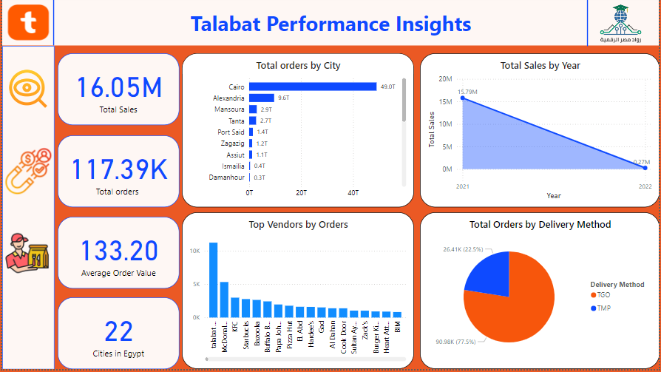
Dashboard

Slide 15
Dashboard Analysis
This dashboard tracks customer acquisition across vendors, platforms, zones, and payment methods, while highlighting retention trends over time.
New Customers: 3,709
Vendors: 5,327
Zones: 59
Affordable Orders: 39K
Key Visuals:
Top Vendor for Customer Acquisition: Talabat Mart
Customer Acquisition Trend: Decline from 1,251 in September 2021 to 5 in January 2022
Top Zones by Acquisition: Alexandria (276), Giza (273)
Platform Usage: Android leads with 69.91%, iOS 28.2%
Payment Methods: Cash (75K successful), Online-Talabat (1K successful, 1K failed)
Customer Retention: Increased retention from September to December 2021

Slide 16
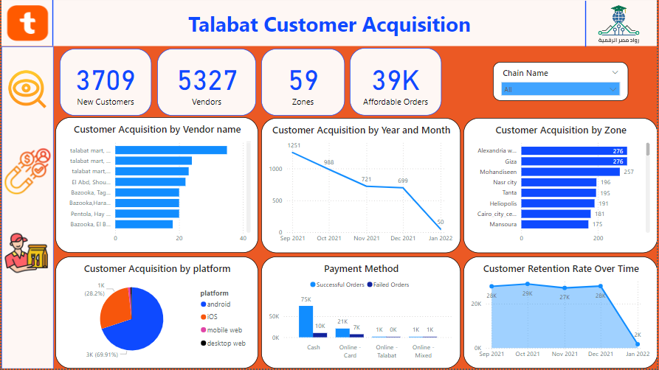
Dashboard

Slide 17
Dashboard Analysis
This dashboard evaluates Talabat’s delivery performance, tracking order success and failure, delivery times, payment methods, and cuisine preferences, helping optimize service efficiency.
Successful Orders: 98.20K
Failed Orders: 19.19K
Average Actual Delivery Time: 1.19K minutes
Average Promised Delivery Time: 1.40K minutes
Key Visuals:
Average Order Delay: Increased delay over time, peaking at 93.63 minutes in early 2022.
Orders by Cuisine: Burgers lead with 9.3K orders, followed by grocery and pizza.
Successful vs. Failed Orders by Cuisine: High success rates in burgers (83.96%) and grocery (84.5%).
Successful Orders by Payment Method: Cash dominates with 75.99% of successful orders.
Failed Orders by Year and Month: Peaks in December 2021 (5.1K failed orders).
Voucher Total Amount by Category: Food leads with 1.6M in voucher total.

Slide 18
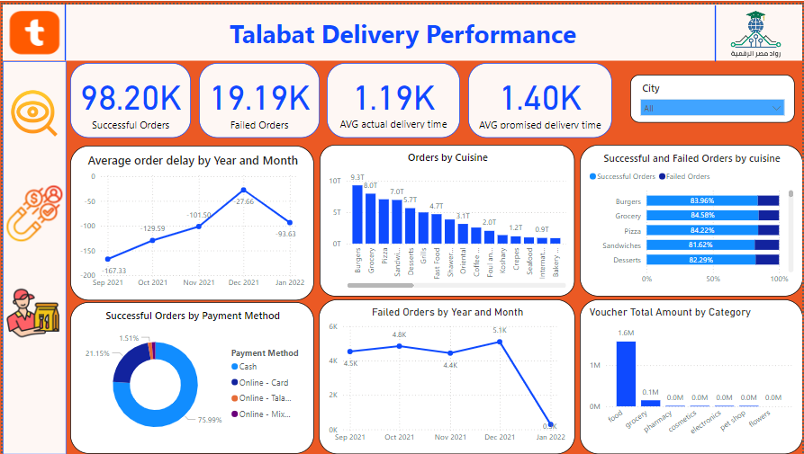
Dashboard

Slide 19

Actionable Recommendations
2. Delivery Performance
Reduce Average Order Delay: The increasing average delay (from -167.33 to -93.63 minutes) signals a growing issue with timely deliveries. Focus on operational improvements such as better route planning, optimizing driver availability, or using predictive analytics to improve delivery estimates.
Improve Delivery Performance for Grocery and Pizza Orders: While grocery and pizza are popular, they have higher failure rates (15.4% and 15.78% failure rates respectively). Investigate vendor performance and delivery logistics to reduce these failures, possibly by working with vendors to streamline preparation time or ensuring faster dispatch.
Monitor Cuisine-Specific Issues: Categories like desserts (81.62%) and sandwiches (81.62%) have lower success rates. Consider improving vendor communication or revising delivery methods for these items to ensure freshness and accuracy.

Slide 20
Actionable Recommendations
3. Payment Method Optimization
Increase Online Payment Adoption: Cash dominates (75.99%), but online payment failures are still present. To encourage online payment adoption, address the reasons behind payment failures by reviewing the payment gateway and improving transaction security. Offering discounts for online payments could also reduce cash dependency.

Slide 21
Actionable Recommendations
4. Voucher and Promotional Strategy
Maximize Voucher Usage in Non-Food Categories: Vouchers in categories like food (1.6M) have the highest usage, while categories such as electronics and toys show minimal engagement. Revise the voucher strategy to include more appealing deals in underperforming categories to drive additional sales.

Slide 22
03
ML Model

Slide 23
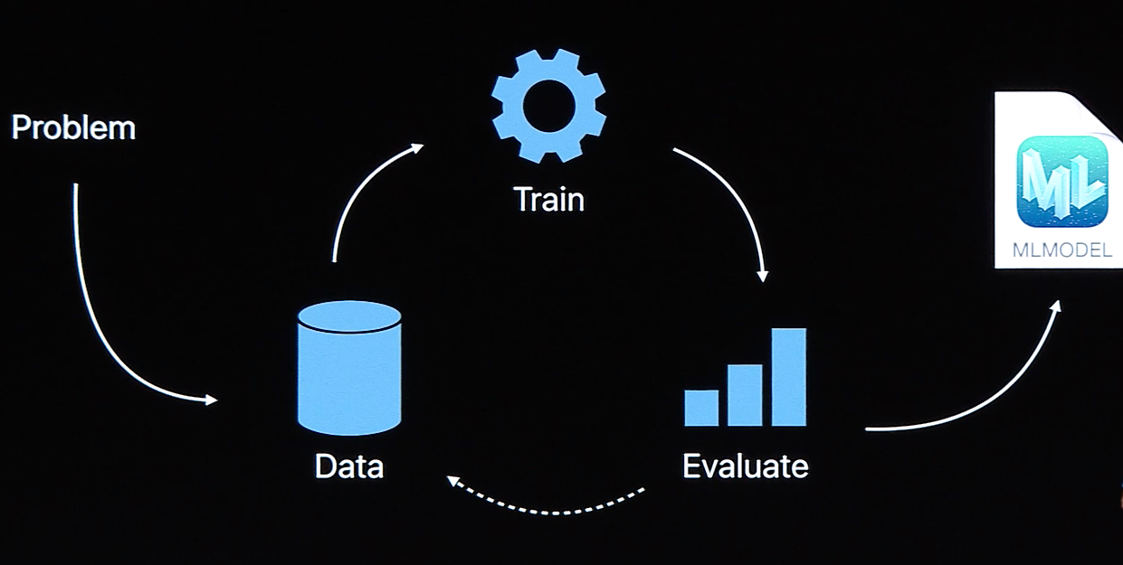
LINEAR REGRESSION MODEL
We used a linear regression model to predict the actual delivery time with accuracy 75%
Model Notebook

